Slide 1

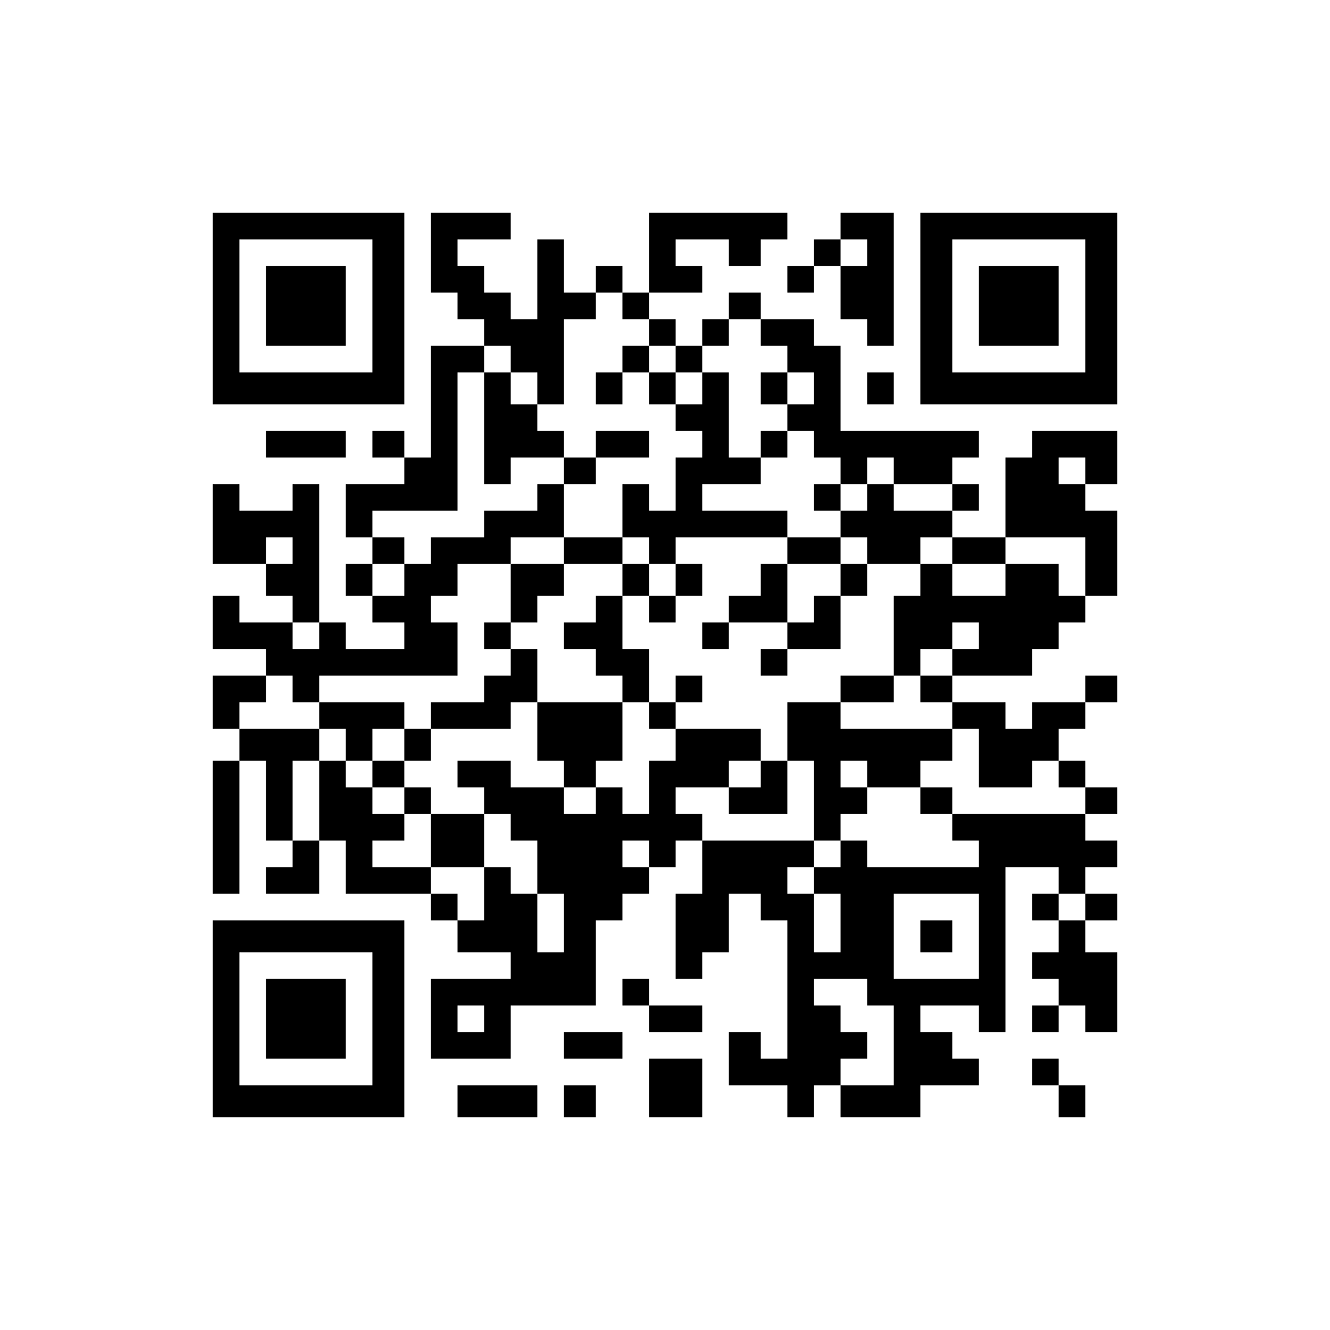
INSY7315 | WORK INTEGRATED LEARNING
Kinsmen
Barbershop
Scan to explore
the live app
kinsmen-web.onrender.com
A connected booking, barber management and product-shop experience.
Emerald Solutions

Slide 2
WHAT WE SOLVED
One place for the
barbershop journey.
The platform brings appointments, staff availability and product stock into one easy-to-use experience.
Customers
Barbers
Administrators
Find a service, choose a suitable barber, book a time, and manage appointments.
See assigned work, control availability and keep service delivery organised.
Manage staff, skills, services, shop products and stock with oversight.
Kinsmen Barbershop | Expo display | 2

Slide 3
CUSTOMER EXPERIENCE
From browse to booking
in a few clear steps.
1 Sign in securely
2 Select a service
3 Choose a suitable barber
4 Pick an available time
5 Add products if wanted
6 Manage or book again
The booking flow prevents customers from selecting a barber who is not qualified for the chosen service.
Kinsmen Barbershop | Expo display | 3

Slide 4
BUILT FOR THE WHOLE TEAM
Role-based tools make
daily operations clearer.
Barber workspace
Administrator workspace
View bookings
Set availability or blocked periods
See assigned services
Keep the day organised
Manage services and barber skills
Maintain staff and roles
Create products and update stock
Monitor the platform
Kinsmen Barbershop | Expo display | 4

Slide 5
PRODUCT SHOP & STOCK
A shop that works with
the booking journey.
Browse with confidence
Protect available stock
Keep staff in control
Customers can see product details and stock status before adding items to a booking.
Reserved items are recorded with the booking and released when a booking is cancelled.
Admins add products, images and descriptions, and adjust stock levels as needed.
Status labels make it easier to spot fully stocked, low-stock and out-of-stock products.
Kinsmen Barbershop | Expo display | 5

Slide 6
HOW IT WORKS
Reliable technology behind
a simple customer experience.
Browser
Secure access
Application API
Cloud data
Delivery
→
→
→
→
Responsive MVC web app
Auth0 authentication
Booking and shop rules
MongoDB Atlas
Docker, Render and CI
The architecture keeps authentication, application rules and cloud data responsibilities separate.
Kinsmen Barbershop | Expo display | 6

Slide 7
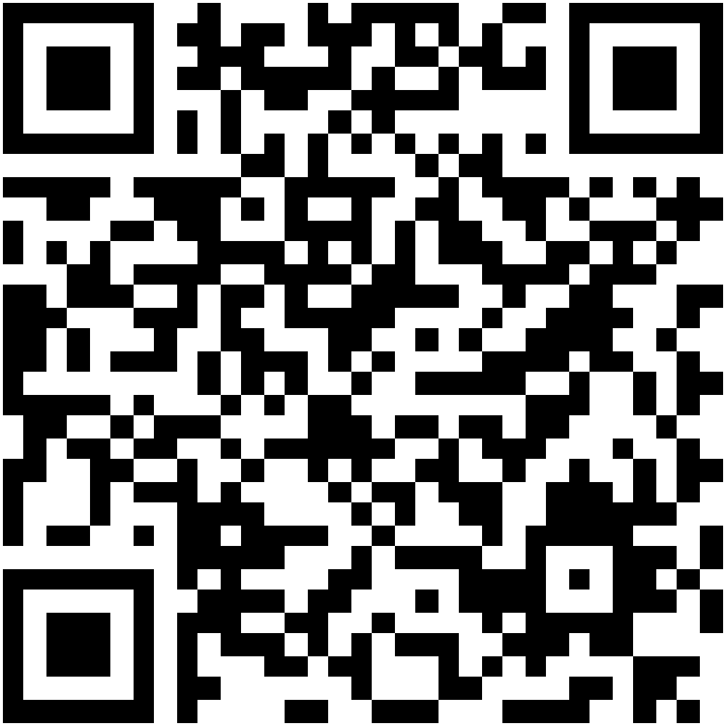
THANK YOU
Try the Kinsmen
experience today.
Bookings. Barbers. Products. One connected barbershop platform.
LIVE APP
DOCUMENTATION
Scan to book and explore
Scan to read the updated project docs
Meet Emerald Solutions
kinsmen-web.onrender.com
github.com/Kaehil-I
Zario Di Paolo • Kaehil Indurjeeth
Kyra Naidoo • Gregory Luyckfasseel

